Slide 1
BANK LOAN CASE STUDY
FINAL PROJECT- 2
Devika Passi
Data Analytics- Trainee

Slide 2
PROJECT DESCRIPTION
Through this case study, we will develop a basic understanding of risk analytics in banking and financial services and understand how data is used to minimize the risk of losing money while lending to customers.
Business Understanding:
The loan providing organizations find it hard to give loans to the individuals due to their inadequate or non-existent credit history. Hence, a few consumers use it to their benefit by turning into a defaulter. We need to use EDA to analyze the patterns present in the data. This will guarantee that the applicants capable of repaying the loan are not rejected.

Slide 3
At the point when the organization gets a loan application, the organization needs to decide for loan approval based on the applicant’s profile. Two types of risks are associated with the bank’s decision:
In the event that the candidate is probably going to reimburse the loan, then not approving the loan results in a loss of business to the company.
In the event that the candidate isn't probably going to reimburse the loan, for example he/she is probably going to default, then, at that point, approving the loan may lead to a financial loss for the company.

Slide 4
At the point when a client applies for a loan, there are four sorts of choices that could be taken by the client/organization:
Approved: The company has approved loan application
Cancelled: The client dropped the application at some point during approval. Either the client changed her/his mind about the loan or in some cases due to a higher risk of the client he received worse pricing which he did not want.
Refused: The organization had dismissed the loan (in light of the fact that the client doesn't meet their prerequisites and so on).
Unused Offer: Loan has been dropped by the client yet on different stages of the process.
We will use EDA to understand how consumer attributes and loan attributes influence the tendency of default.

Slide 5
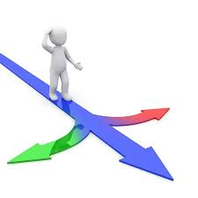
APPROACH
Present the overall approach of the analysis. Mention the problem statement & the analysis approach briefly.
Problem Statement : This case study aims to recognize patterns which indicate if a client experiences any issues paying their installments which might be utilized for taking actions such as denying the loan, reducing the amount of loan, lending at a higher interest rate to risky applicants, and so on. This will guarantee that the consumers capable of repaying the loan are not rejected.
In other words, the company wants to understand the driving factors (or driver variables) behind loan default, i.e. the variables which are strong signs of default.

Slide 6




The dataset given contains the information about the loan application at the time of applying for the loan. It contains two sorts of situations:
The client with payment difficulties : he/she had late payment more than X days on at least one of the first Y instalments of the loan in our sample.
All other cases: Any remaining situations when the installment is paid on time.

Slide 7
Analysis Approach:
We identified the missing data first, and used appropriate method to deal with it.
Identify if there are outliers in the dataset , (data points that are far from other data points and they can distort statistical results)
Identified data imbalance and understand the ratio of imbalance.
Interpret the results of univariate, segmented univariate, bivariate analysis, etc. in business terms.
Visualize the data using various charts.

Slide 8
Identify the missing data and use appropriate method to deal with it. (Remove columns/or replace it with an appropriate value)
There are a total of 122 columns in the table Application data. Out of which 9152465 data entries are missing, which is about 32%. In the table previous_application, there are 37 columns. Out of which 23% entries are blank values.
We replace these values that might be needed for the analysis using mean, median (numerical data) and mode (categorical data).
Also, we realise that WEEKDAY_APPR_PROCESS_START, HOUR_APPR_PROCESS_START, EXT_SOURCE_2, EXT_SOURCE_3 has no correlation with the target column. We drop these columns from the dataset.

Slide 9
The columns which contain information about the enquiries to the credit bureau also seem to have no correlation with target column. So, we drop these as well.
Dropping all of these columns leaves us with 112 columns in application_data table.
Also some columns having days in negative, needs to be converted to positive value.
Imputed categorical variable ‘NAME_TYPE_SUITE’ using mode , ‘AMT_DOWN_PAYMENT’ , ‘AMT_GOODS_PRICE’ using mode, ‘AMT_ANNUITY’ using median.
Working file link:
https://docs.google.com/spreadsheets/d/19iGkmuM2NCQFmg-58Yjg2rxYYyR849qV/edit?usp=sharing&ouid=116245242206104902236&rtpof=true&sd=true

Slide 10
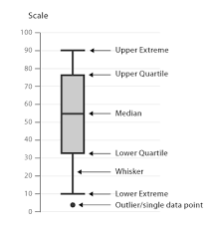
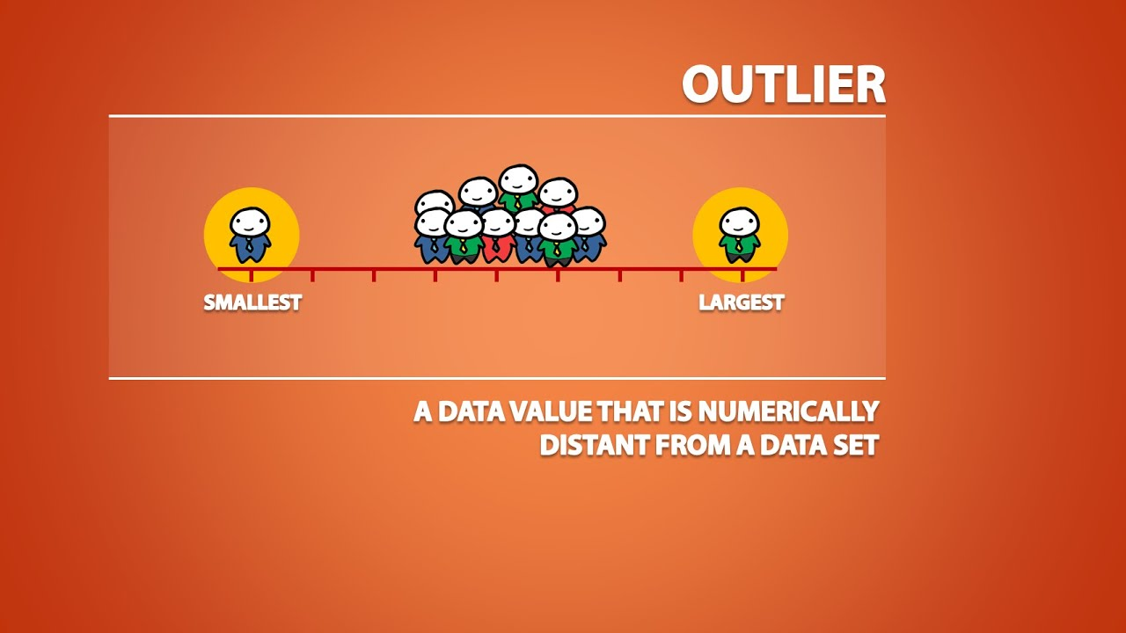
Identify if there are outliers in the dataset. Also, mention why do you think it is an outlier.
An outlier is a value that is significantly higher or lower than most of the values in your data. When using Excel to analyze data, outliers can skew the results.
A way of checking for outliers is to simply plot a box and whisker chart. We can then clearly visualize the outliers in the data.

Slide 11
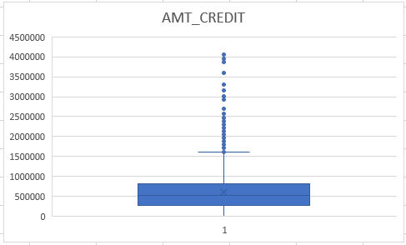
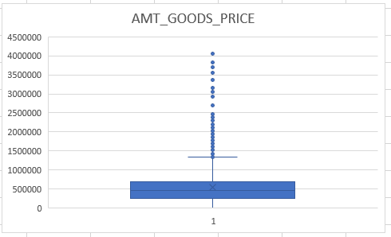
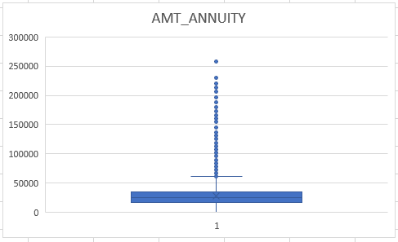
AMT_CREDIT, AMT_ANNUITY, AMT_GOODS_PRICE have some number of outliers.
AMT_CREDIT has a value as high as 40 lakhs, this value is very very high than the rest of the population. And a credit amount can only be exceptionally this high.
Similarly, AMT_ANNUITY has a point with value around 2lakhs , and this value is also very high than the monthly payment that the rest of the population will pay. Hence, these points are considered outliers.

Slide 12
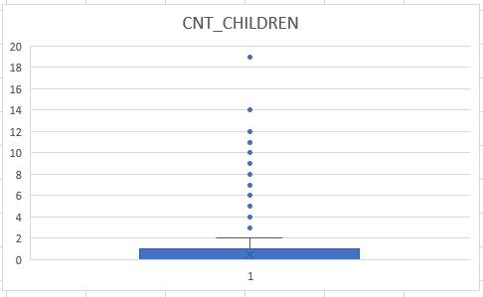
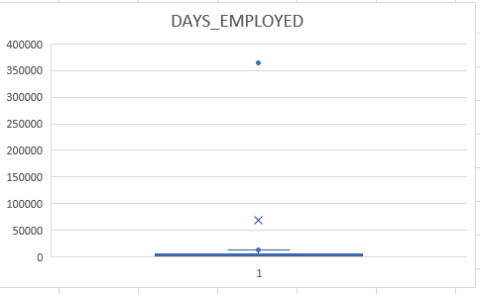
CNT_CHILDREN has outlier values of 12, 14 and 19, which is highly unlikely as it is very rare to have these number of children, and hence is an outlier value.
Similarly, DAYS_EMPLOYED has outlier values around 350000 days, which is around 958 years which is impossible, and has to be an incorrect entry.

Slide 13
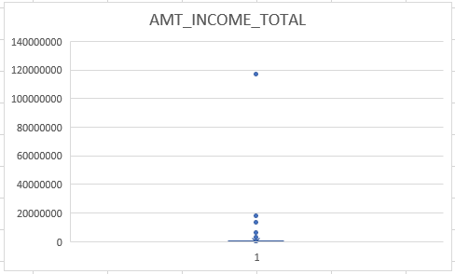
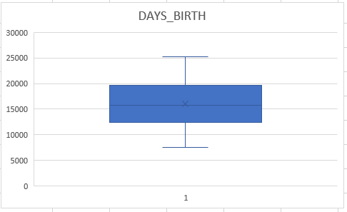
AMT_INCOME_TOTAL has huge number of outliers which indicates that few of the loan applicants have high income as compared to others. For example, a person has a total income as high as 11 crores, which is very very high than the rest of the population. Hence, it is an outlier.
DAYS_BIRTH has no outliers which means the data available is reliable

Slide 14
Hence, we identified several points/values in the dataset which differ significantly from the rest of the values.
These data points when used in data analysis might skew the results. Hence, it is necessary to deal with these values before we further go ahead with our further analysis.
We might want to remove these values from the dataset, or we might want to replace these values or simply identify these values.
In any case, outlier detection is a crucial step before we begin our analysis, If the outliers are non-randomly distributed, they can decrease normality. It increases the error variance and reduces the power of statistical tests.

Slide 15
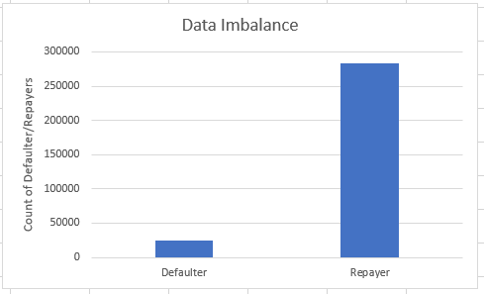
Identify if there is data imbalance in the data. Find the ratio of data imbalance.
Imbalanced data refers to those types of datasets where the target class has an uneven distribution of observations, i.e. one class label has a very high number of observations and the other has a very low number of observations.
This data is highly imbalanced as we can see
from this column chart . Number of defaulters
Is very less in the total population. Data
imbalance ratio is 11.39 :1 (approx.) , repayer
to default. That is, for every defaulter there are
12 repayers.

Slide 16


TECH STACK USED
Microsoft Excel : It allows user to record data in the form of tables. It is easy to analyze data in an Excel spreadsheet. Doing calculations has become easier and less time-taking with the formulas option in MS excel.
PowerPoint : It is used to make report to be presented to the leadership team.

Slide 17
INSIGHTS
Explain the results of univariate, segmented univariate, bivariate analysis, etc. in business terms.
1. UNIVARIATE ANALYSIS
Analysis where the data being analyzed contains only one variable and since it’s a single variable it doesn’t deal with causes or relationships. The main purpose of univariate analysis is to describe the data and find patterns that exist within it.
In Segmented Univariate analysis the data variable is divided and patterns can be observed across the segments. It is used to find summary of a single data variable in form of segments.

Slide 18
In most of the cases, we see from the column chart, that the applicants were unaccompanied.
Most of the people who applied for the loan were working type, nearly 1 lakh 58 thousands, and were mostly educated as secondary/ secondary special, as we see in the next visual.

Slide 19
It is evident that most of the loan applicants live in a house/apartment (~2 lakhs).
From the above chart, we infer that most of the loan applications were given by married people
From visual 6, we infer that laborers were the ones who took maximum number of loans

Slide 20
2. BIVARIATE ANALYSIS
Correlation is a bivariate analysis that measures the strength of association between two variables and the direction of the relationship and Bivariate analysis is used to find out if there is a relationship between two different variables.
Female candidates took more loan than the male candidates and paid on time as well.
There isn’t much difference between clients owning a car and having/ or not having payment difficulties. Same is the case with owning real estate as we see in visual 3.

Slide 21
Most people who applied for loan had 1-3 children.
People living in co-op apartments and office apartments are less likely to be defaulters.
Loan applicants who have up to 4 members in family are more likely to pay back on time

Slide 22
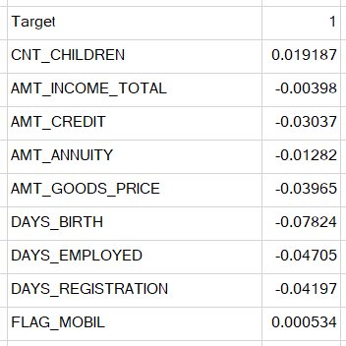
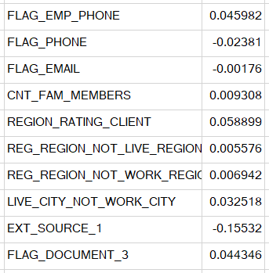
Find the top 10 correlation for the Client with payment difficulties and all other cases (Target variable).

Slide 23
Heatmap:
I made 3 different heatmap to check the correlations with respect to the target variable. With 1 being directly correlated, 0 being not related and -1 being inversely related.
CNT_CHILDREN being the most positively correlated with the target variable, this variable in days mentioned negatively and from the histogram plot, we inferred that there is likelihood to repay loan, if the number of children is less.
2. There is neither positive nor negative relation, all other columns shows similar trend. The value came out to be almost equal to zero.
3. There exist weak negative correlation between ext_source and target variable, so similar to that of days_birth variable, those applicants who has good score from external source tends to repay loan more.

Slide 24
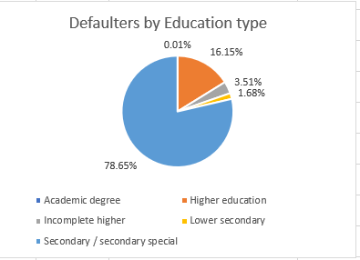
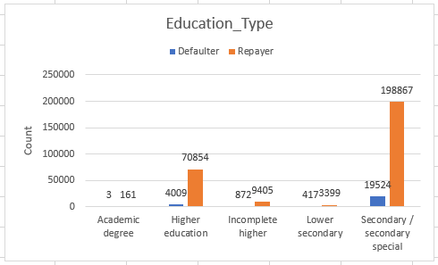
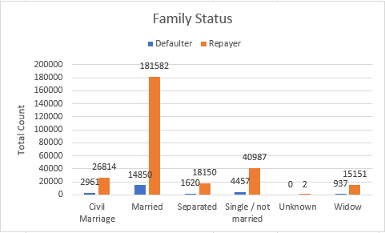
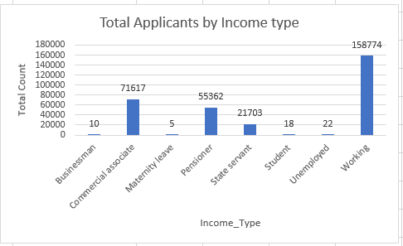
Include visualizations and summarize the most important results in the presentation.

Slide 25
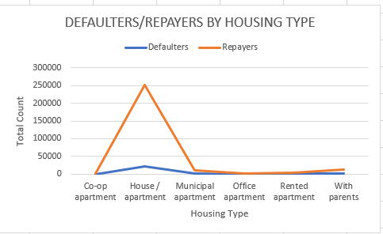
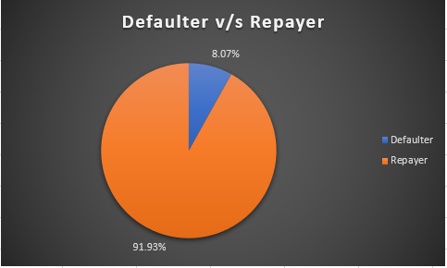
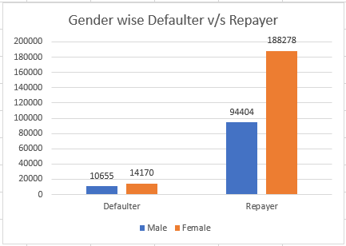

Slide 26
RESULTS
Identified the applicants who may have difficulty paying their installments, based on the dataset given.
Applied EDA in this real business case scenario.
Identified the missing data, outliers and data imbalance in a huge dataset given.
Visualized the huge dataset in the form of charts, graphs for better understanding.
We saw that majority of the applicants were unaccompanied , that is came alone.
Also, we saw that most of the applicants lived in house/apartment, or are married, belong to working class paid on time.
Payment difficulty arises with people who are widow and have a civil marriage, are unemployed with lower education, have more than 5 children.

Slide 27
We also saw that female candidates were the ones who paid back on time, unlike male applicants who had payment difficulty.
We also analyzed columns OWN_CAR and OWN_REALTY for applicants who have their own car or real estate and inferred that there was no direct relation of whether they will pay on time or not.
Through columns target v/s housing type, we analyzed that a major chunk of applicants live in house/ apartment. The clients who face payment difficulty are the ones who live with parents or in rented apartments.

Slide 28
THANK YOU

